Slide 1
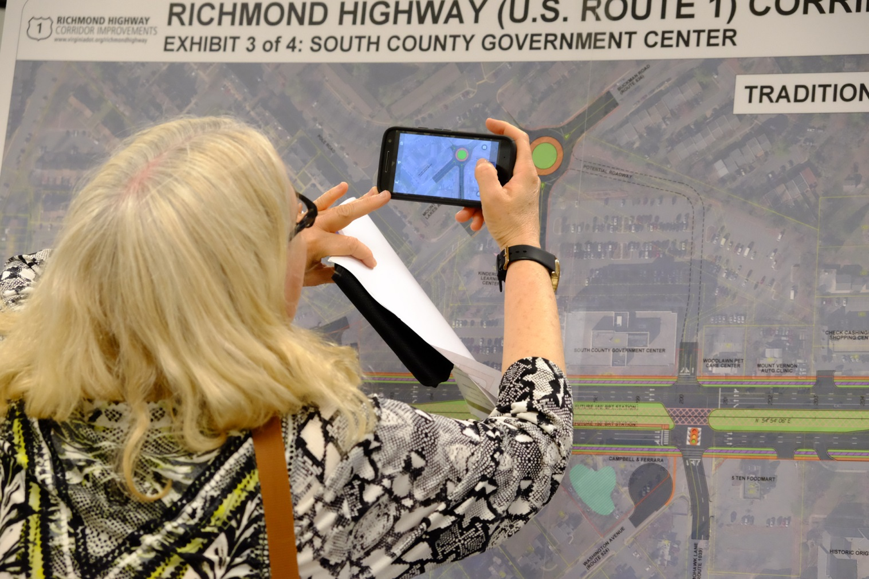
Major Projects in Development
Richmond Highway (Route 1)
Three-mile widening, bike/ped facilities in coordination with Fairfax County Bus Rapid Transit planning. Anticipated Cost: $215 million
Proposed Schedule:
Draft Environmental Assessment: Late 2017
Public Hearing: 2018
Right of Way: 2019
Construction: 2023

Slide 2
Planning for Next Round of Investments -TransAction Update
Performance Based Analysis on Corridors and Segments
15 Performance Measures
Approximately 352 multi-modal candidate projects across 11 regional corridors/28 corridor segments
Mega-Projects in Baseline:
Transform 66 (inside and outside the beltway)
I-95/395 Express Lanes
Mega-Projects in Draft TransAction Plan:
American Legion Bridge
Bi-County Parkway
Metrorail Extensions/VRE Expansion
Potomac River Crossing
Route 28 Widening
Route 1 Widening with Bus Rapid Transit
Regional Bus Rapid Transit Network
Fiscally Unconstrained
$42 Billion
Not enough $$ to fund all of the needs
2

